Slide 1

Network Services Interface
Use of NML SwitchingService
John MacAuley, ESnet
22nd September 2014

Slide 2
Agenda
Discuss the NML SwitchingService and changes made to the published NML schema.
Label Swapping and how it is modeled.
Associating ServiceDefinitions with a SwitchingService.
Mapping to the NSI ServiceDomain.
Next steps.

Slide 3
Switching Service
A SwitchingService describes the ability to create new Links from any of its inbound Ports to any of its outbound Ports.
A SwitchingService may have the following attributes:
  id is assign a persistent globally unique URI.
  encoding is assign a data encoding identifier associated with the SwitchingService.
  labelSwapping. A value of false adds a restriction to the SwitchingService: it is only able to create cross connects from an inbound Port to an outbound Port if the Label of the connected Ports has the same value. The default value is false.
  labelType is assign the label type identifier associated with a Port that is switched by the SwitchingService.
  other and anyAttributes allowing for the inclusion of attributes from other namespaces.
A SwitchingService may have the following element members:
  name to assign a human readable string.
  Relation describe how the SwitchingService relates to other defined NML objects.
  other an ANY definition allowing for the inclusion of element from other namespaces.
Other attributes and elements inherited from NetworkObject and Service are available for use.

Slide 4
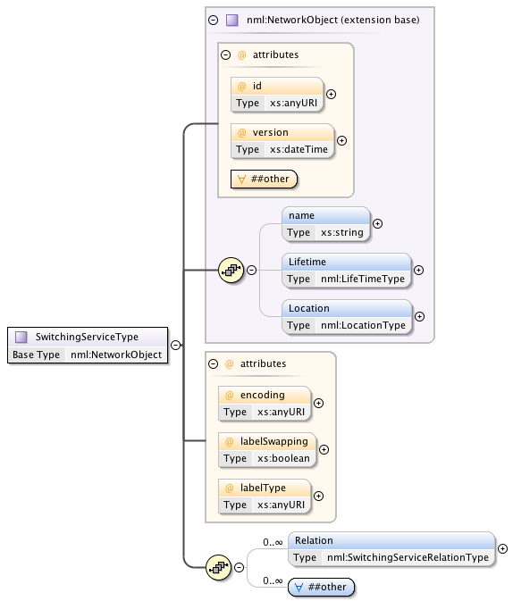
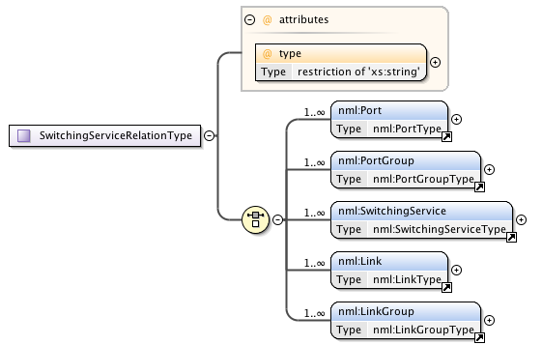
SwitchingService Definitions
Added

Slide 5
Relations
A SwitchingService may have the following relations:
  existsDuring to one or more Lifetimes
  hasInboundPort to one or more Ports or PortGroups
  hasOutboundPort to one or more Ports or PortGroups
  isAlias to one or more Switching Services
  providesLink to one or more Links or LinkGroups. The providesLink relation points to Links which describe the currently configured cross connects in a SwitchingService.
hasInboundPort
*
Port
hasOutboundPort
*
Port
SwitchingService
*
hasInboundPort
*
PortGroup
hasOutboundPort
*
PortGroup

Slide 6
Label Swapping
The SwitchingService supports the concept of label swapping.
If the labelSwapping attribute is set to true then any port within the SwitchingService can be connected to any other port independent of label value.
If set to false, then only ports with equivalent labels can be interconnected.
The labelType attribute identifies the type of label the SwitchingService will switch.
A Port or PortGroup may have at most one labelType.

Slide 7
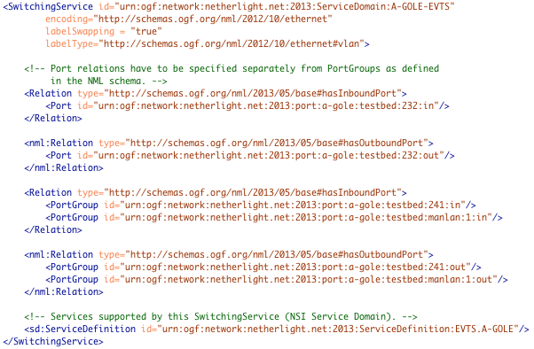
Example
The SwitchingService supports the concept of label swapping. If the labelSwapping attribute is set to true then any port within the SwitchingService can be connected to any other port independent of label. If set to false, then only ports with equivalent labels can be interconnected.
labelSwapping set to “true” indicates that ports can be connected with different label values.
labelType indicates the label that could be switched.
Port elements can be members of SwitchingService.
PortGroup elements can also be members of SwitchingService.
ServiceDefinition associated with this SwitchingService.

Slide 8
Ethernet
We are using the following Ethernet namespace for our NML documents:
    http://schemas.ogf.org/nml/2012/10/ethernet
The encoding attribute on both the SwitchingService and Port/PortGroup elements will use the following URL if they support Ethernet:
    http://schemas.ogf.org/nml/2012/10/ethernet
The labeltype attribute in the SwitchingService and Label/LabelGroup elements will use the following URL if they support IEEE 802.1Q Ethernet:
    http://schemas.ogf.org/nml/2012/10/ethernet#vlan

Slide 9
Ethernet (continued)
A Label element associated with an Ethernet port will contain a single VLAN value and have the “labeltype” set to http://schemas.ogf.org/nml/2012/10/ethernet.
A LabelGroup element associated with an Ethernet port will contain one or more VLAN values and have the “labeltype” set to http://schemas.ogf.org/nml/2012/10/ethernet.
A LabelGroup supports comma and hyphen separated ranges such as “1-1770,1780-2000,2002,2006”.

Slide 10
Default behavior no SwitchingService
If no SwitchingService is specified within the NML Topology element then this implies a single SwitchingService for each supported labelType/encoding pair, containing all unidirectional ports of that labelType and encoding specified using the "has*Port" relations, all defined ServiceDefinitions supporting the encoding, and the labelSwapping attribute set to false.
Ports defined with no labels are matched on encoding type only and placed in a SwitchingService defined with no labelType or labelSwapping attributes.
Ports defined with no encoding are matched on labelType only (if available) and placed in a SwitchingService defined with no encoding attribute, however, labelType and labelSwapping attributes can be present if used as a matching criteria.

Slide 11
Specifying a wildcard SwitchingService
When a specific default behavior is required, a SwitchingService can be specified in the NML Topology element with wildcard behaviors.
All ports matching the wildcard specification of the defined SwitchingService are included in that SwitchingService.
When a wildcard SwitchingService is defined the default SwitchingService behavior is no longer used.
A wildcard SwitchingService is specified within the NML Topology element similar to a normal SwitchingService specification except no Relation elements are included.
The lack of Relation elements implies the SwitchingService includes any Port/PortGroups that match the specified labelType and encoding of that SwitchingService.

Slide 12
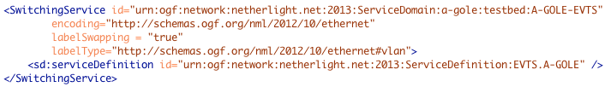
Continued…
For example, the following wildcard SwitchingService is defined that includes all ports using a "vlan" lableType and an "ethernet" encoding. This SwitchingService is defined with labelSwapping set to "true" and with the "EVTS.A-GOLE" ServiceDefinition:
If there are ports defined within the NML Topology element that do not match a defined SwitchingService then these ports are not connectable.

Slide 13
NSI Service Domain
In a Service Domain any STP can be connected to any other STP with the following constraints:
  Unidirectional inbound STP can only be connected to unidirectional outbound STP.
  Bidirectional ports can only be interconnected to other bidirectional ports.
A Service Domain has an associated Service Definition (SD) describing the service being offered.
Service Domains are grouped into Network topologies that can be advertised by at most one NSA.
An NSA can advertise multiple Network topologies.
The SwitchingService element is used to model NSI Service Domains.
A single SwitchingService declaration can expand into many NSI Service Domains depending if label swapping is supported or not (a domain per label value).

Slide 14
Service Domain Mappings
Service Domain 1
Label A
Service Domain 2
Label B
Service Domain Labels
A, B, C
SwitchingService
labelSwapping = false
SwitchingService
labelSwapping = true
Service Domain 3
Label C

Slide 15
Next Steps
Need to get an official designation for modified NML (errata, new version, etc.)
NSA implementations need to incorporate new NML schema (in current form it is backwards compatible).
Network deployments need to advertise their SwitchingService elements in NML topology documents.
Path finders start utilizing the information to better model ServiceDomains within a network.

Slide 16
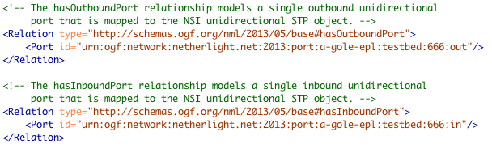
NSI Service Termination Points
The Port element maps to a unidirectional STP.
From these two port definitions we would generate the following unidirectional STP identifiers:
  urn:ogf:network:netherlight.net:2013:port:a-gole-epl:testbed:666:out
  urn:ogf:network:netherlight.net:2013:port:a-gole-epl:testbed:666:in

Slide 17
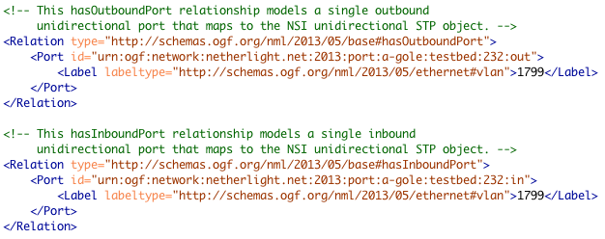
Unidirectional STP from Port and Label
The Port element maps to a unidirectional STP.
The Label elements contains a single value that is used to fully qualify an STP. From these two port definitions we would generate the following STP identifiers:
  urn:ogf:network:netherlight.net:2013:port:a-gole:testbed:232:out?vlan=1799
  urn:ogf:network:netherlight.net:2013:port:a-gole:testbed:232:in?vlan=1799

Slide 18
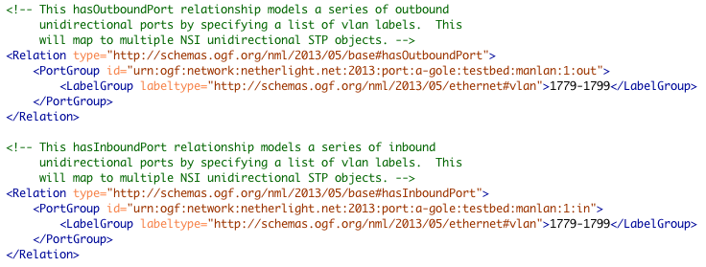
Unidirectional STP from PortGroup and LabelGroup
The PortGroup element is a summary mechanism used to specify
a mapping to one or more unidirectional STP.
The LabelGroup elements can contain a range of values that are used to generate fully qualify STP or underspecified STP. From these two port definitions we would generate the following underspecified STP identifiers:
  urn:ogf:network:netherlight.net:2013:port:a-gole:testbed:232:out?vlan=1779-1799
  urn:ogf:network:netherlight.net:2013:port:a-gole:testbed:232:in?vlan=1779-1799
For fully qualified STP we would get 20 of each inbound and outbound built as on the previous slide.

Slide 19
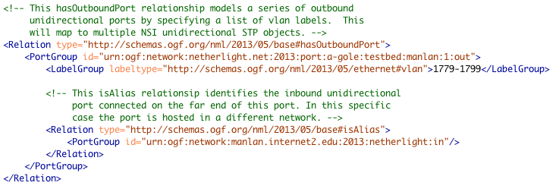
NSI Service Demarcation Points
The Port and PortGroup elements may contain an isAlias relationship indicating connectivity to another Port or PortGroup. We use this isAlias relationship to create an SDP between the adjacent STP generated from the Port or PortGroup elements.

Slide 20
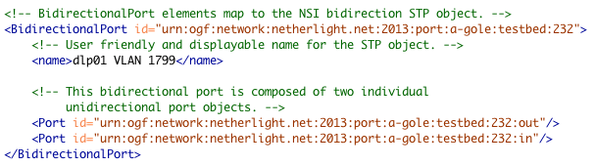
Bidirectional STP
The BidirectionalPort element groups a pair of inbound and outbound Port or PortGroup elements to create a bidirectional STP.
The BidirectionalPort id is used as the root for the bidirectional STP identifier, but we must also navigate to the unidirectional Port/PortGroup definitions to determine any labels being used. The following bidirectional STP identifier would be created based on the unidirectional Port specification:
  urn:ogf:network:netherlight.net:2013:port:a-gole:testbed:232?vlan=1799

Slide 21
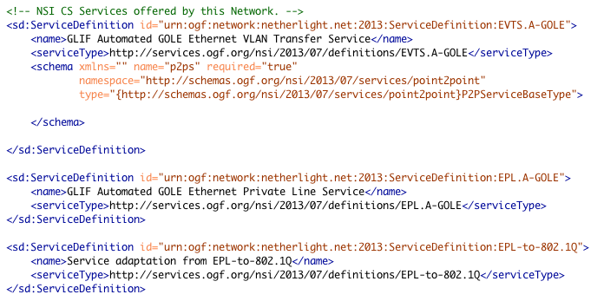
NSI CS Services
…
Full service definition can
be included.
Reference to Service
Definition type
…
Adaptation Service Definition type

Slide 22
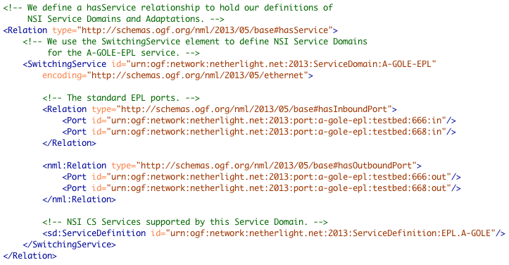
NSI Service Domain
The SwitchingService element is used to model NSI Service Domains. A single SwitchingService declaration can expand into many NSI Service Domains depending if label swapping is supported. Inbound and outbound Port/PortGroup elements are specified as members.
The ServiceDefinition element identifies the services supported in this Service Domain.

Slide 23
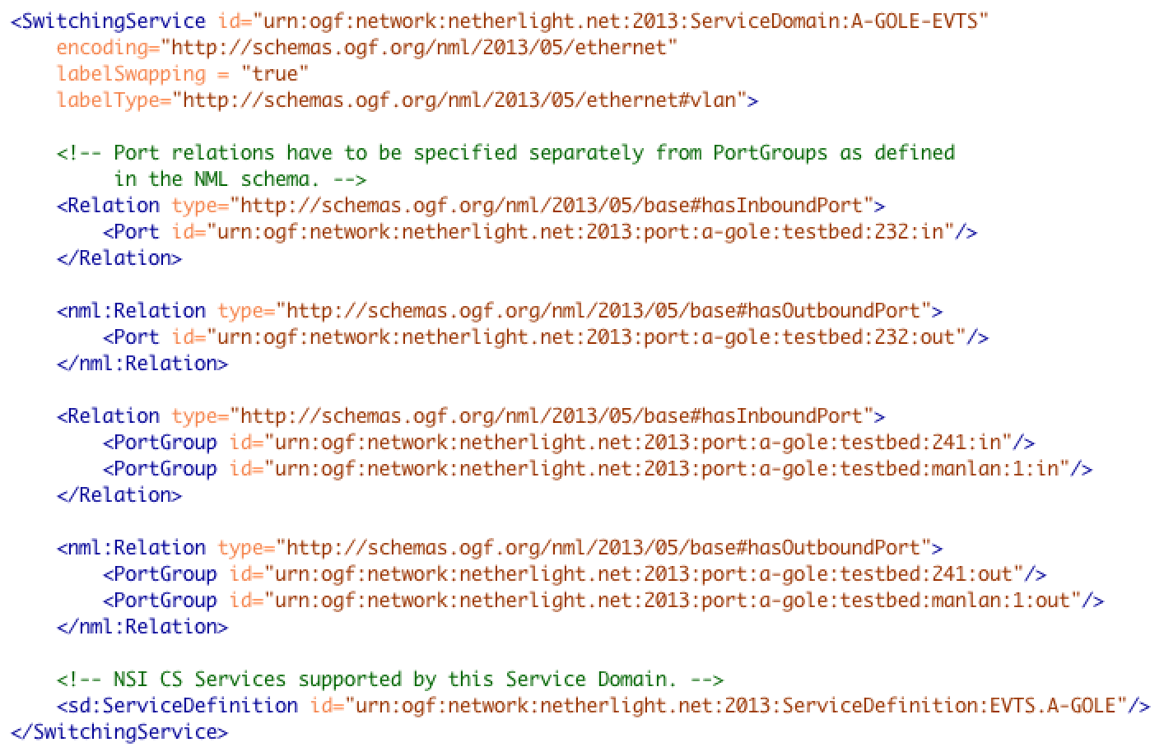
Label Swapping
The SwitchingService supports the concept of label swapping. If the labelSwapping attribute is set to true then any port within the SwitchingService can be connected to any other port independent of label. If set to false, then only ports with equivalent labels can be interconnected.
labelSwapping set to “true” indicates that ports can be connected with different label values.
labelType indicates the label that could be switched.
Port elements can be members of
SwitchingService.
PortGroup elements can also be members of SwitchingService.

Slide 24
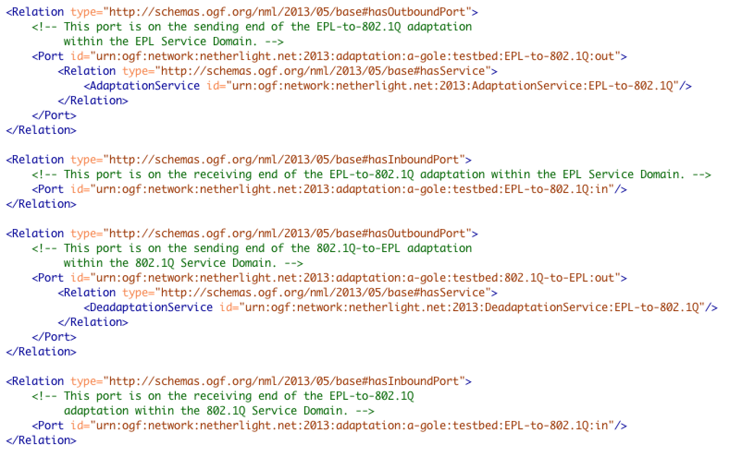
Adaptation Port Definition
Adaptation is port based in NML, so to model an adaptation between NSI Service Domains, we must create special STP for referencing within the Adaptation. In our specific case, we create four unidirectional ports per adaptation. The outbound port from the source Service Domain #1 references the AdaptationService, and the AdaptationService references the inbound port of the destination Service Domain #2. Similarly, for deadaptation the outbound port in Service Domain #2 references the DeadaptationService, and the DeadaptationService references the inbound port on Service Domain #1.
Outbound Port elements reference the (De)AdaptationService.

Slide 25
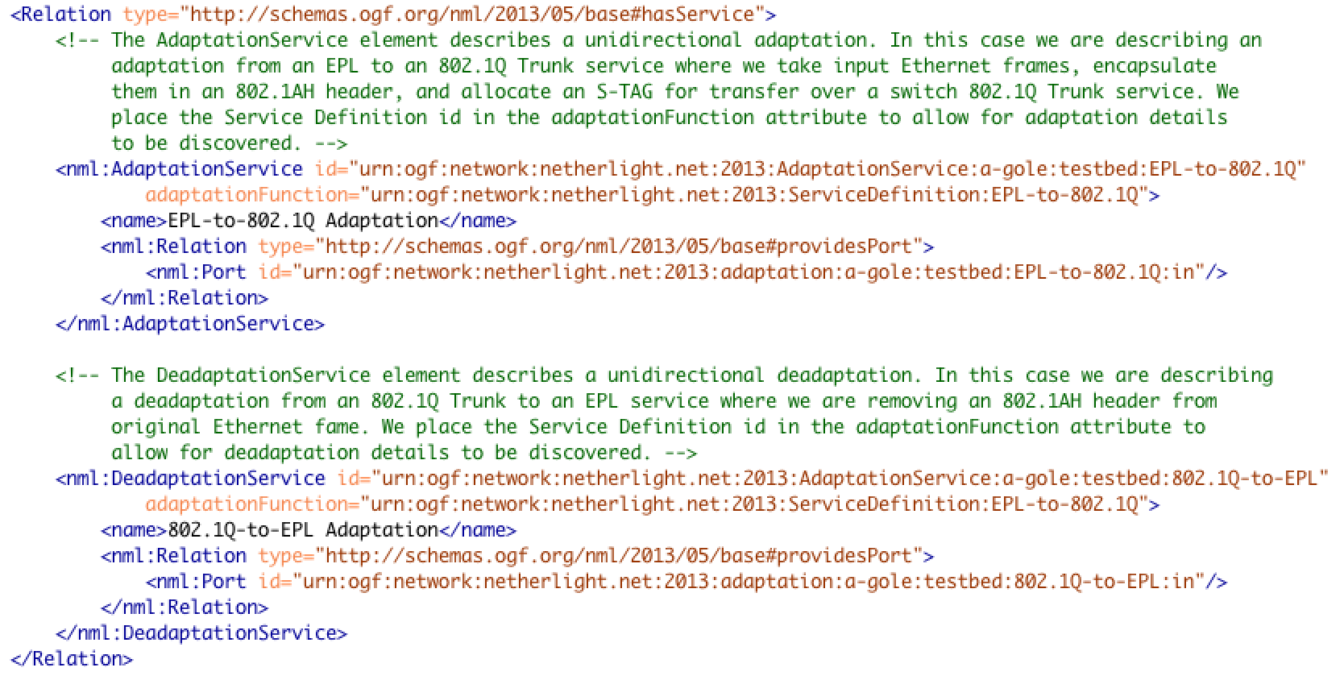
Adaptation Service Definition
Adaptation Id is referenced by source port.
Service Definition for adaptation is referenced by Id.
Target port of adaptation.
Target port of deadaptation.
Service Definition for deadaptation must be same reference Id as adaptation.

